Slide 1

Lua
Ethan Reinsborough

Slide 2

What is Lua?
Lua is a powerful, efficient, lightweight, embeddable scripting language.
Lua is compiled and written in ANSI C (Standard C) and uses a simple C API to embed itself into applications. This allows it to support cross-platform usage, although Lua programs are usually developed on Linux operating systems.
It supports procedural programming, object-oriented programming, functional programming, data-driven programming, and data description.
Notes:
https://www.lua.org/about.html

Slide 3

History of Lua
Lua was created in 1993 by Roberto Ierusalimschy. It is currently being maintained and designed by a team at PUC-Rio, a university in Brazil.
Lua is not an abbreviation, it literally means “moon” in Portuguese.
Notes:
https://www.lua.org/about.html

Slide 4
How Does Lua Work?
Lua combines simple procedural syntax with powerful data description constructs. It is a dynamically typed language (variable types are checked during runtime).
Lua runs by interpreting bytecode with a register-based virtual machine. It has automatic memory management with incremental garbage collection.
Lua was created with speed, portability, extensibility, and ease-of-use in mind.
This makes Lua ideal for configuration, scripting, and rapid prototyping.
Notes:
https://www.lua.org/about.html

Slide 5
Popular Software Made With Lua
Lua has been used in many industrial applications:
Adobe Photoshop Lightroom, Apache HTTP Server, MySQL Workbench, Vim etc.
Lua is very popular in the video game community, often seen as one of the most popular scripting languages. A few games that are made in/use Lua scripting are:
World of Warcraft, Angry Birds, Roblox, Garry’s Mod, Warframe, Dota 2, Factorio, etc.
Notes:
https://www.lua.org/about.html
https://en.wikipedia.org/wiki/List_of_applications_using_Lua#Video_games

Slide 6
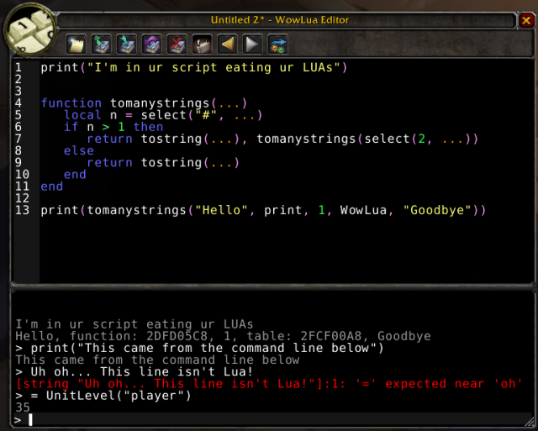
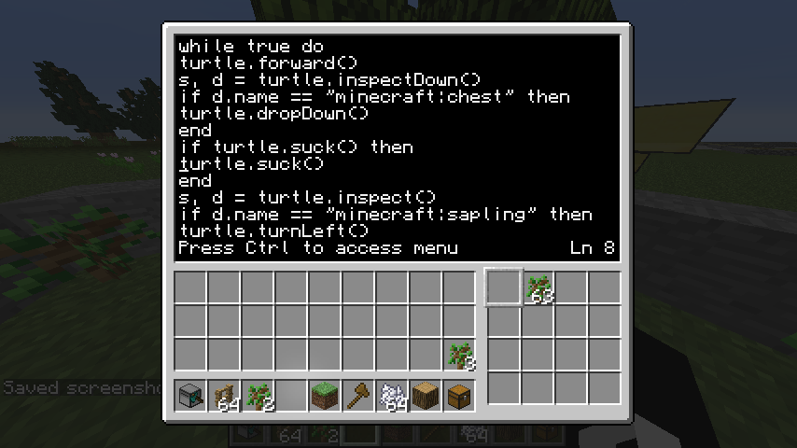
Some Examples of Lua Scripting
World of Warcraft
Minecraft (ComputerCraft)

Slide 7
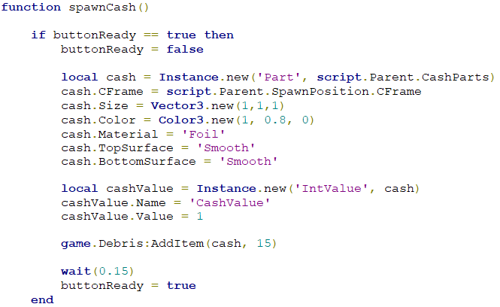
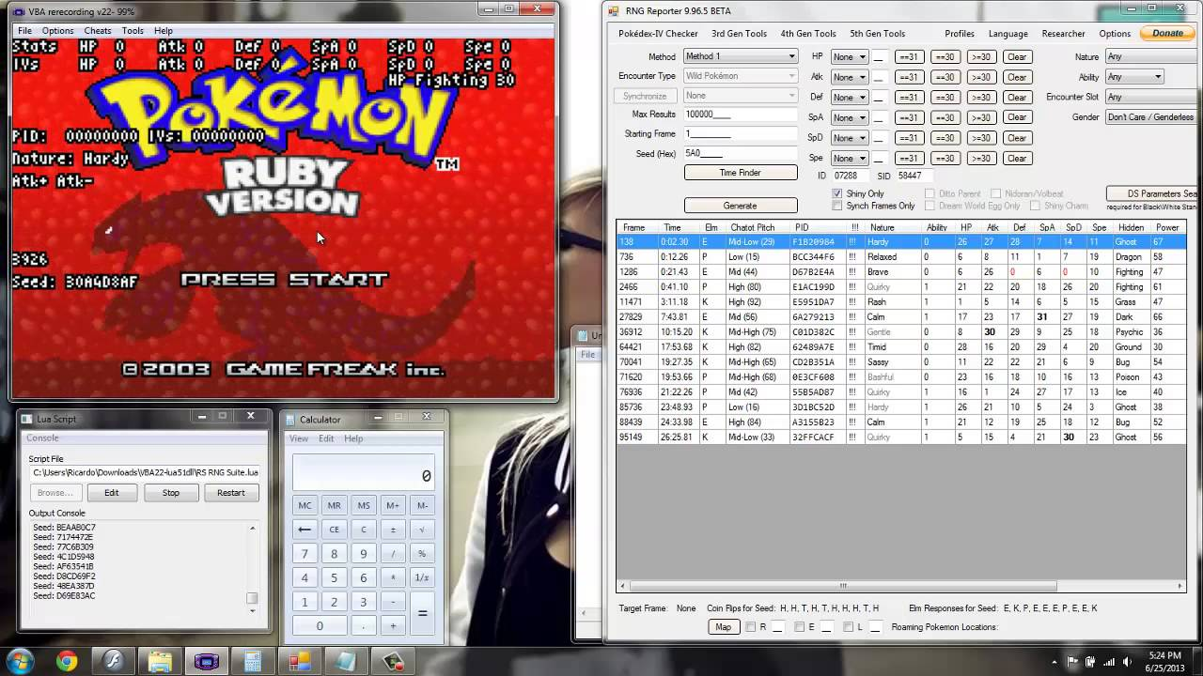
Scripting Examples Continued
Roblox
Emulators

Slide 8
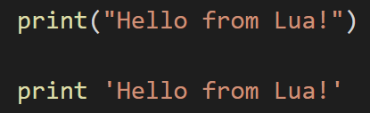
Getting Started With Lua - Basics
As per tradition, we will start off with a simple “Hello World” message
No semicolons!

Slide 9
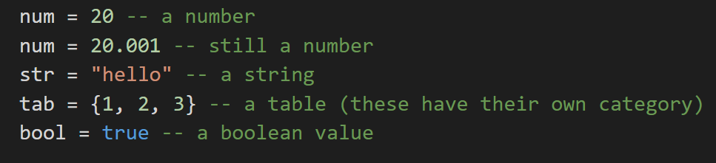
Types
Lua uses loosely-typed variables by default. There are variants of Lua that allow for strongly-typed variables but they are not as commonly used.
Notes:
https://riptutorial.com/lua

Slide 10
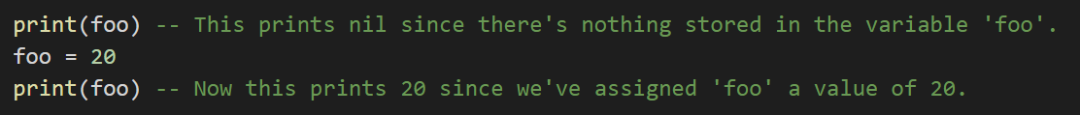
The Nil Type
Lua has its very own special type called nil. The purpose of nil is to be different from all other values. It is basically a non-value value (almost like null but not quite).
Notes:
https://riptutorial.com/lua

Slide 11
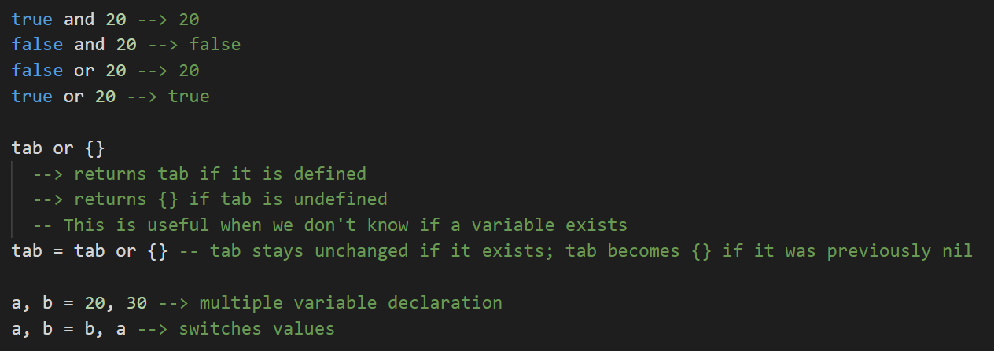
Expressions
Notes:
https://riptutorial.com/lua

Slide 12
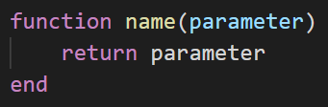
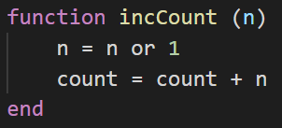
Functions
Functions are created with the following syntax:
Example function:

Slide 13
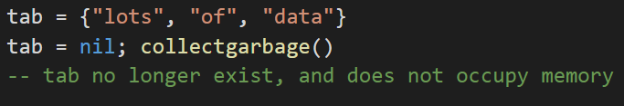
Garbage Collection
Garbage collection is an important feature of Lua, as it allows for efficient memory usage.

Slide 14
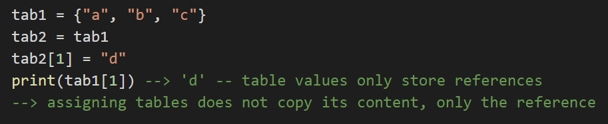
Tables
Tables are another special property of Lua. They are like arrays, but as with nil vs null, they are not quite the same.

Slide 15
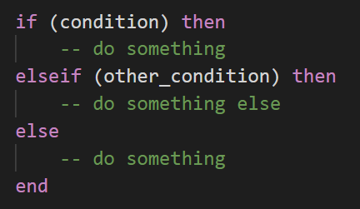
Conditions
Conditions in Lua are the same as conditions in other languages, except for the “end” keyword.

Slide 16
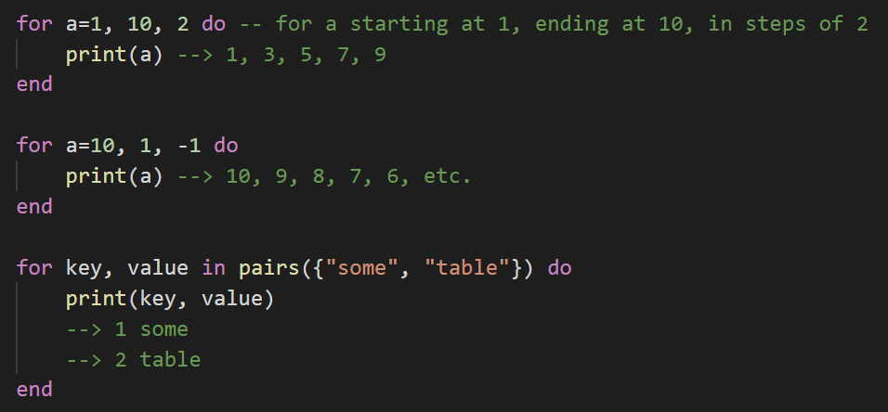
Loops
While loops in Lua are the same as in most languages, so we will focus on for loops as they have some unique implementations.
If the step expression is not defined, Lua assumes a default step of 1

Slide 17
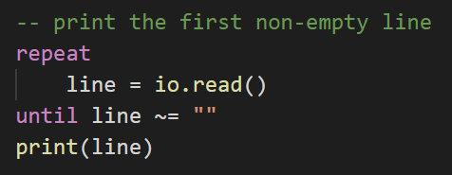
Loops - Repeat
As the name implies, a repeat-until statement repeats its body until its condition is true. The test is done after the body, so the body is always executed at least once.
Notes:
https://www.lua.org/pil/4.3.3.html

Slide 18
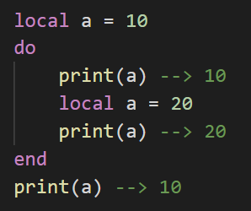
Do Blocks
As shown below, do blocks are a section of code that represent a “local instance”. Assigning values within a block will cause those values to revert after the block is completed.

Slide 19
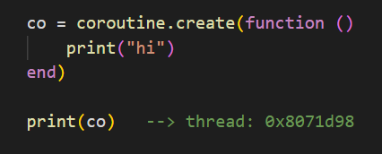
Coroutines
A coroutine is a line of execution with its own stack, local variables, and instruction pointer. However, coroutines share general variables and mostly anything else with other coroutines.
Lua offers all its coroutine functions in the coroutine table. The create function creates new coroutines. It has a single argument, which is a function with the code that the coroutine will run. It returns a value of type thread, which represents the new coroutine.

Slide 20


Coroutines Continued
A coroutine can be in one of three different states: suspended, running, and dead. When created, a coroutine starts in the suspended state. This means that its code is not automatically executed until specified. The status of a coroutine can be checked with the status function.
To execute the code in the previous slide, we simply write:
The coroutine will then terminate and revert to a “dead” state from which it cannot return.
Notes:
Coroutines are rather complex and have many uses, but we will just cover the basics for this presentation. (Coroutines also show up in other languages and are not Lua-specific!)

Slide 21
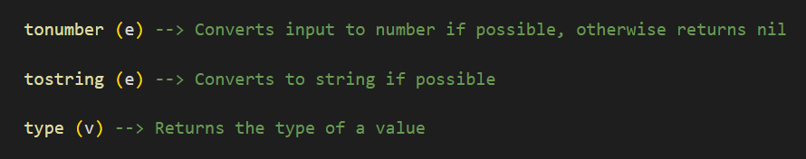
Lua Predefined Functions
Lua has many predefined functions to simplify coding (most of which are based off C functions).

Slide 22
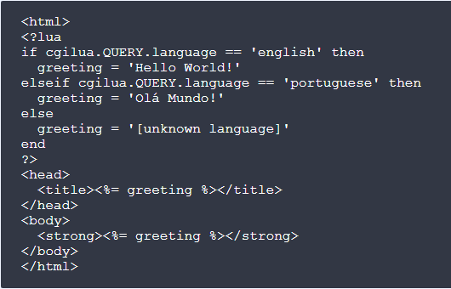
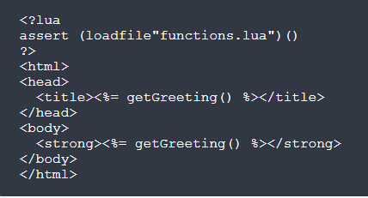
Lua / HTML
As with PHP and JSP, Lua can be embedded into HTML pages.

Slide 23
Let's get started!

Slide 24

https://www.roblox.com/create

Slide 25
Research References
https://www.lua.org/start.html
https://www.lua.org/pil/contents.html
https://www.lua.org/pil/1.html
https://www.youtube.com/watch?v=iMacxZQMPXs
https://www.youtube.com/watch?v=XCwXWOe6VcU
https://code.labstack.com/lua
https://riptutorial.com/lua
https://compasstech.com.au/TNS_Authoring/Scripting/script_tut1.html
https://keplerproject.github.io/cgilua/manual.html
https://riptutorial.com/ebook/lua
http://luajit.org/install.html
http://lua-users.org/wiki/SampleCode
https://en.wikipedia.org/wiki/Lua_(programming_language)
https://wowwiki-archive.fandom.com/wiki/Lua
https://www.youtube.com/watch?v=Pvnqg8XgDfw
https://devforum.roblox.com/t/lua-scripting-starter-guide/394618
https://chdk.fandom.com/wiki/Execute_Lua_scripts_with_hostlua_%26_notepad%2B%2B
https://developer.roblox.com/en-us/api-reference

Slide 26
Scripting References
https://www.reddit.com/r/pokemonrng/comments/ug2mr/using_lua_scripts_for_gen_iii_emulator_rng/
https://pksvuiscripting.weebly.com/basic-scripting.html
https://www.youtube.com/watch?v=PBUAf3e7F7o
https://www.youtube.com/watch?v=LtGm7e9gd0Y
https://www.youtube.com/watch?v=3DkZmcGySMk
http://forums.therockmanexezone.com/lua-script-folder-editor-t15188.html
https://www.twilio.com/blog/how-to-write-lua-scripts-for-video-games-with-the-bizhawk-emulator
http://fceux.com/web/help/LuaGettingStarted.html
https://www.reddit.com/r/lua/comments/6xhrx3/how_to_learn_lua/
http://www.computercraft.info/forums2/index.php?/topic/18789-ccemuredux-computercraft-emulator-redux/

